Slide 1
Input-Output
Abylkassymova A.B.

Slide 2

Getting User Input
Most of the application interact with the user.
Because computers are designed to serve user needs.
An application must provide some means of obtaining user input.
Input could be gotten from database, file, keyboard, another computer, …
In PYTHON it is easy to implement.
You simply use the input() function to do it.

Slide 3
Reading Keyboard Input:
Python provides two built-in functions to read a line of text from standard input, which by default comes from the keyboard. These functions are:
raw_input
input

Slide 4
The raw_input Function:
The raw_input([prompt]) function reads one line from standard input and returns it as a string (removing the trailing newline):
str = raw_input("Enter your input: ");
print "Received input is : ", str
This would prompt you to enter any string and it would display same string on the screen.
When I typed "Hello Python!", it output is like this:
Enter your input: Hello Python
Received input is : Hello Python

Slide 5
Input() Function
The input([prompt]) function is equivalent to raw_input, except that it assumes the input is a valid Python expression and returns the evaluated result to you:
str = input("Enter your input: ");
print "Received input is : ", str
This would produce following result against the entered input:
Enter your input: [x*5 for x in range(2,10,2)]
Recieved input is : [10, 20, 30, 40]
Always outputs a string;
Even if a user types a number!
You need to convert it after receiving the input.

Slide 6
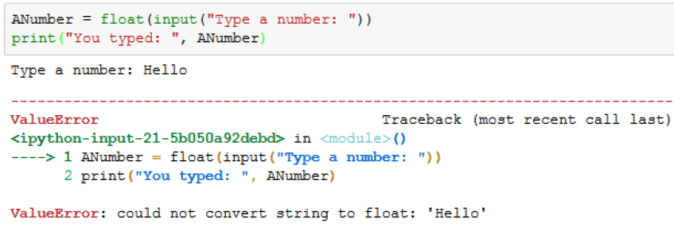
Converting input
Understand that data conversion isn’t without risk.
If you attempt to type something other than a number, you get an error message.

Slide 7
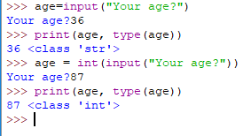

More examples
Quite a messy ☹

Slide 8

Another method
Looks better!

Slide 9
Opening /Closing Files

Slide 10
Opening and Closing Files:
Until now, you have been reading and writing to the standard input and output. Now we will see how to play with actual data files.
Python provides basic functions and methods necessary to manipulate files by default. You can do your most of the file manipulation using a file object.
The open Function:
Before you can read or write a file, you have to open it using Python's built-in open() function. This function creates a file object which would be utilized to call other support methods associated with it.

Slide 11
Syntax
file object = open(file_name [, access_mode][, buffering])
file_name: The file_name argument is a string value that contains the name of the file that you want to access.
access_mode: The access_mode determines the mode in which the file has to be opened ie. read, write append etc. A complete list of possible values is given below in the table. This is optional parameter and the default file access mode is read (r)
buffering: If the buffering value is set to 0, no buffering will take place. If the buffering value is 1, line buffering will be performed while accessing a file. If you specify the buffering value as an integer greater than 1, then buffering action will be performed with the indicated buffer size. If negative, the buffer size is the system default(default behavior).

Slide 12
A list of the different modes of opening a file:
Modes | Description
r | Opens a file for reading only. The file pointer is placed at the beginning of the file. This is the default mode.
rb | Opens a file for reading only in binary format. The file pointer is placed at the beginning of the file. This is the default mode.
r+ | Opens a file for both reading and writing. The file pointer will be at the beginning of the file.
rb+ | Opens a file for both reading and writing in binary format. The file pointer will be at the beginning of the file.
w | Opens a file for writing only. Overwrites the file if the file exists. If the file does not exist, creates a new file for writing.
wb | Opens a file for writing only in binary format. Overwrites the file if the file exists. If the file does not exist, creates a new file for writing.
w+ | Opens a file for both writing and reading. Overwrites the existing file if the file exists. If the file does not exist, creates a new file for reading and writing.

Slide 13
A list of the different modes of opening a file:
wb+ | Opens a file for both writing and reading in binary format. Overwrites the existing file if the file exists. If the file does not exist, creates a new file for reading and writing.
a | Opens a file for appending. The file pointer is at the end of the file if the file exists. That is, the file is in the append mode. If the file does not exist, it creates a new file for writing.
ab | Opens a file for appending in binary format. The file pointer is at the end of the file if the file exists. That is, the file is in the append mode. If the file does not exist, it creates a new file for writing.
a+ | Opens a file for both appending and reading. The file pointer is at the end of the file if the file exists. The file opens in the append mode. If the file does not exist, it creates a new file for reading and writing.
ab+ | Opens a file for both appending and reading in binary format. The file pointer is at the end of the file if the file exists. The file opens in the append mode. If the file does not exist, it creates a new file for reading and writing.

Slide 14
The file object atrributes:
Once a file is opened and you have one file object, you can get various information related to that file.
Here is a list of all attributes related to file object:
Attribute | Description
file.closed | Returns true if file is closed, false otherwise.
file.mode | Returns access mode with which file was opened.
file.name | Returns name of the file.

Slide 15
Examples
fo = open("foo.txt", "wb")
print ("Name of the file: ", fo.name)
print ("Closed or not : ", fo.closed)
print ("Opening mode : ", fo.mode)
This would produce following result:
Name of the file: foo.txt
Closed or not : False
Opening mode : wb

Slide 16
The close() Method:
The close() method of a file object flushes any unwritten information and closes the file object, after which no more writing can be done.
Python automatically closes a file when the reference object of a file is reassigned to another file. It is a good practice to use the close() method to close a file.
Syntax:
fileObject.close();
Example:
fo = open("foo.txt", "wb")
print "Name of the file: ", fo.name
fo.close()
This would produce following result:
Name of the file: foo.txt

Slide 17
Reading and Writing Files:
The file object provides a set of access methods to make our lives easier. We would see how to use read() and write() methods to read and write files.
The write() Method:
The write() method writes any string to an open file. It is important to note that Python strings can have binary data and not just text.
The write() method does not add a newline character ('\n') to the end of the string:
Syntax:
fileObject.write(string);

Slide 18
Example:
fo = open("foo.txt", "w+")
fo.write( "Python is a great language.\nYeah its great!!\n");
fo.close()
The above method would create foo.txt file and would write given content in that file and finally it would close that file. If you would open this file, it would have following content
Python is a great language.
Yeah its great!!

Slide 19
The read() Method:
The read() method read a string from an open file. It is important to note that Python strings can have binary data and not just text.
Syntax:
fileObject.read([count]);
Here passed parameter is the number of bytes to be read from the opend file. This method starts reading from the beginning of the file and if count is missing then it tries to read as much as possible, may be until the end of file.
Example:
fo = open("foo.txt", "r+")
str = fo.read(10);
print ("Read String is : ", str)
fo.close()
This would produce following result:
Read String is : Python is

Slide 20
File Positions:
The tell() method tells you the current position within the file in other words, the next read or write will occur at that many bytes from the beginning of the file:
The seek(offset[, from]) method changes the current file position. The offset argument indicates the number of bytes to be moved. The from argument specifies the reference position from where the bytes are to be moved.
If from is set to 0, it means use the beginning of the file as the reference position and 1 means use the current position as the reference position and if it is set to 2 then the end of the file would be taken as the reference position.

Slide 21
Example:
fo = open("foo.txt", "r+")
str = fo.read(10);
print "Read String is : ", str
position = fo.tell();
print "Current file position : ", position
position = fo.seek(0, 0);
str = fo.read(10);
print "Again read String is : ", str
fo.close()
This would produce following result:
Read String is : Python is
Current file position : 10
Again read String is : Python is

Slide 22
Renaming and Deleting Files:
Python os module provides methods that help you perform file-processing operations, such as renaming and deleting files.
To use this module you need to import it first and then you can all any related functions.
The rename() Method:
The rename() method takes two arguments, the current filename and the new filename.
Syntax:
os.rename(current_file_name, new_file_name)
Example:
import os
os.rename( "test1.txt", "test2.txt" )

Slide 23
The delete() Method:
You can use the delete() method to delete files by supplying the name of the file to be deleted as the argument.
Syntax:
os.remove(file_name)
Example:
import os
os.remove("test2.txt")

Slide 24
Directories in Python:
All files are contained within various directories, and Python has no problem handling these too. The os module has several methods that help you create, remove, and change directories.
The mkdir() Method:
You can use the mkdir() method of the os module to create directories in the current directory. You need to supply an argument to this method, which contains the name of the directory to be created.
Syntax:
os.mkdir("newdir")
Example:
import os # Create a directory "test"
os.mkdir("test")

Slide 25
The chdir() Method:
You can use the chdir() method to change the current directory. The chdir() method takes an argument, which is the name of the directory that you want to make the current directory.
Syntax:
os.chdir("newdir")
Example:
import os
os.chdir("/home/newdir")

Slide 26
The getcwd() Method:
The getcwd() method displays the current working directory.
Syntax:
os.getcwd()
Example:
import os
os.getcwd()

Slide 27
The rmdir() Method:
The rmdir() method deletes the directory, which is passed as an argument in the method.
Before removing a directory, all the contents in it should be removed.
Syntax:
os.rmdir('dirname')
Example:
import os
os.rmdir( "/tmp/test" )

Slide 28
File & Directory Related Methods:
There are three important sources which provide a wide range of utility methods to handle and manipulate files & directories on Windows and Unix operating systems. They are as follows:
File Object Methods: The file object provides functions to manipulate files.
OS Object Methods.: This provides methods to process files as well as directories.

Slide 29
WITH … AS …

Slide 30
EXAMPLE
WITH …. OPEN
with open('testfile.txt', 'a') as the_file:
the_file.write('Hello')
TRY … EXCEPT …
try:
with open("test.txt") as file_handler:
for line in file_handler:
print(line)
except IOError:
print("An IOError has occurred!")

Slide 31
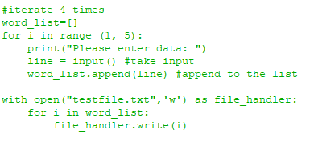
Example

Slide 32
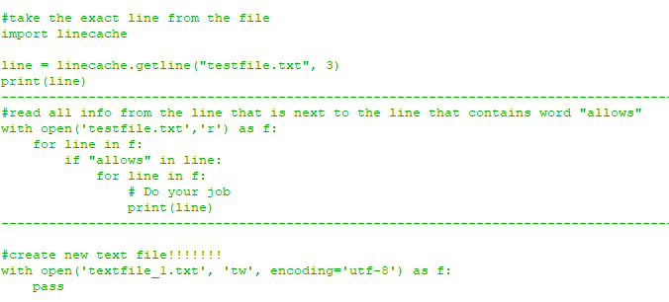
Example

